Slide 1
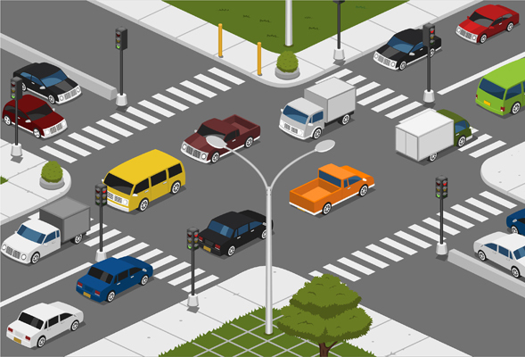
ADVANCED TRAFFIC MANAGEMENT SYSTEM
TEAM GUIDE – DR S. SURESH
TEAM NAME- PROJECTX
BY-
SARTHAK GUPTA (RA1611008010368)
SWASTI SUMEDHA TEWARI (RA1611008010686)
SUMEET OMALUR (RA1611008010384)
TANYA MISHRA (RA1611008010526)

Slide 2
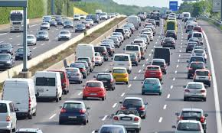
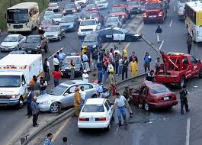
INTRODUCTION
TRAFFIC-CAUSES AND MANAGEMENT
Traffic consists of road users including pedestrians, ridden or herded animals, fast and slow vehicles, streetcars, buses and other conveyances, either singly or together, while using the public way for purposes of travel.
Causes:
Too many cars for the roadway due to inadequate mass transit options or other reasons.
Obstacles in the road causing a blockage and merger. These can be any of the following:
Double parking, Road work, Lane closure etc.
Traffic signals out of sync many times on purpose or occasionally when the computers are malfunctioning.
Inadequate green time
Too many pedestrians crossing not permitting cars to turn etc.

Slide 3
TRAFFIC MANAGEMENT
Traffic management is the organization, arrangement, guidance and control of both stationary and moving traffic, including pedestrians, bicyclists and all types of vehicles. Its aim is to provide for the safe, orderly and efficient movement of persons and goods, and to protect and, where possible, enhance the quality of the local environment on and adjacent to traffic facilities. For effective traffic management, it is essential that the information obtained is factual and reliable. Road inventory, statistical methods, and the more common types of traffic studies, including traffic volume, composition, origin and destination, speed, travel time and delay, accidents and parking are described. "Before and after" studies, and estimation of future traffic are also covered. As a basis for logically applying traffic management techniques it is necessary to develop a classification or hierarchy of all roads to ensure that the primary purpose of each of them is defined, agreed and understood. A functional classification of roads suitable for traffic management purposes, and a process for developing such a system is described.

Slide 4
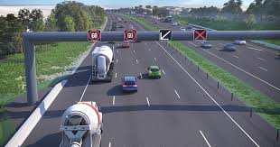
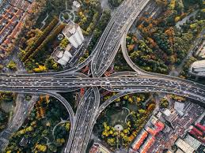
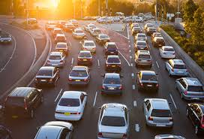
Various aspects of traffic management, including signing and delineation, pedestrian facilities, bicycle facilities, intersections, traffic signals, road capacity, parking, roadside safety and roadway lighting have to be taken into consideration. The objectives of local area traffic management schemes, and a systematic process for developing them are to be described, and the various techniques that may be used and the principles of design of traffic management devices are summarized. The application of traffic management techniques to rural and urban arterial roads respectively is studied, emphasizing the desirability of treating routes or networks as a whole rather than simply focusing on isolated problem spots. Past and likely future trends in road travel, and various techniques for travel demand management are described. The important area of traffic enforcement and the associated aspects of education and encouragement are considered. Unless traffic management is logically applied and consistently enforced, it will not be effective.

Slide 5
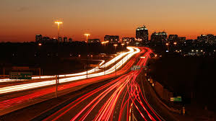
INTRODUCTION
What is ADVANCED TRAFFIC MANAGEMENT SYSTEM?
Advanced Traffic Management system is an integrated solution to manage highway and city traffic through real time information collection, processing, analysis and finally dissemination to the users, concerned agencies and stake holders. To ensure round the clock safety, it is of prime importance to provide real time and precise information to users about the road condition, traffic situations, incidents and weather conditions on the highways and city roads. It is also important to make interventions for smooth, safe and efficient traffic movement by providing rescue and relief to the users to avoid distress.

Slide 6
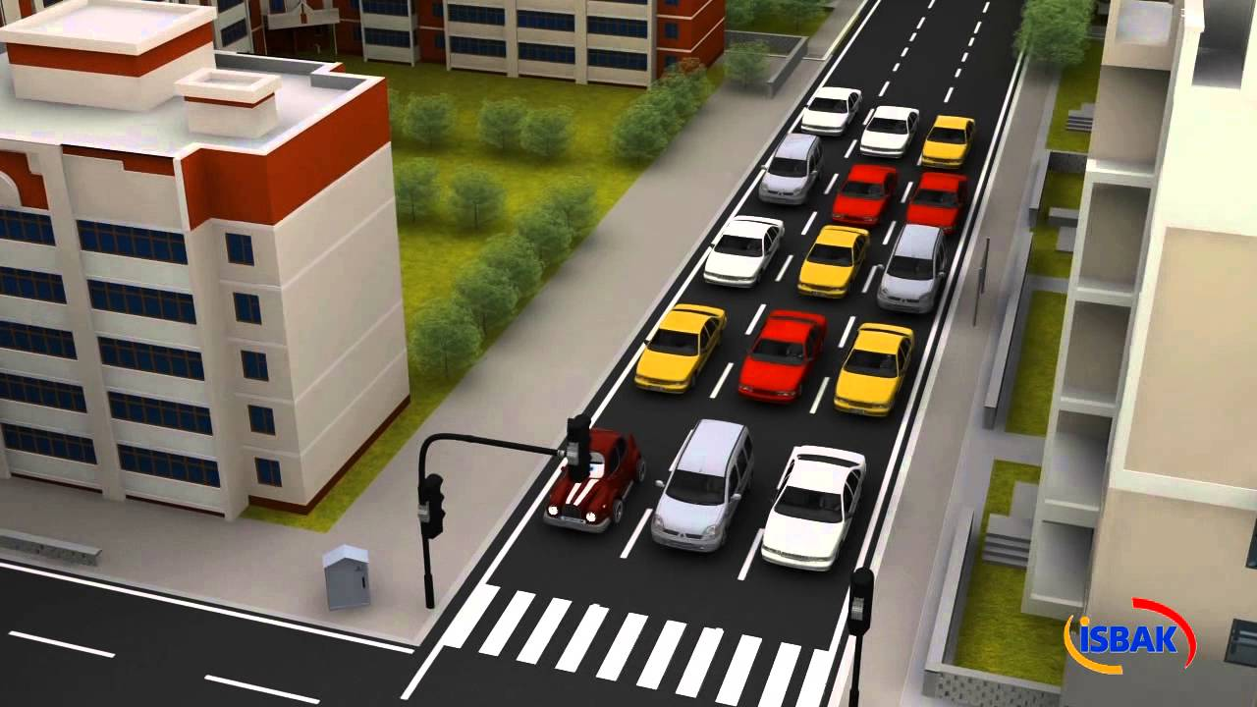
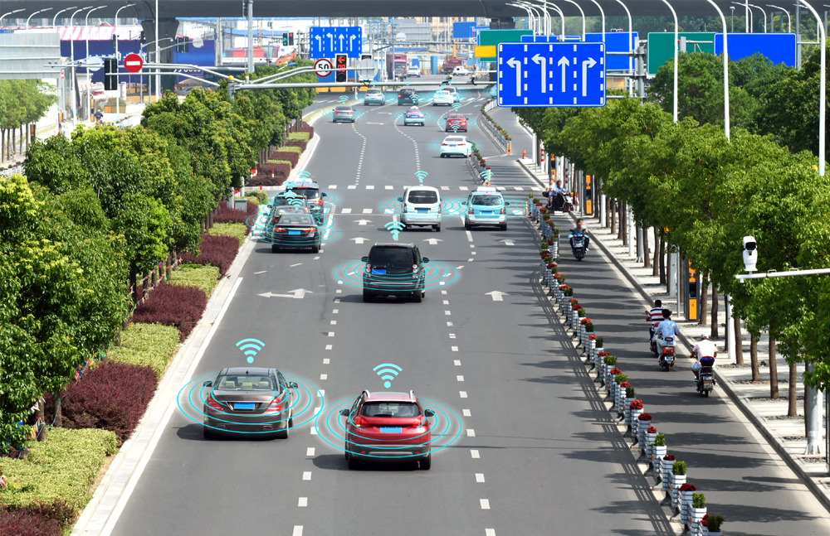
ATMS ensures that clients have the best solutions they need for the future to manage traffic flow intelligently, effectively and meeting with ever-changing operating environment. It is an efficient and cost-effective solution designed, engineered, built and integrated with a balance of customized components and commercially off-the-shelf-products for customer. Advanced traffic management system (ATMS) involves a set of intelligently integrated roadside equipment that are connected to ensure a safe and secure journey, including smooth traffic movement and timely reaction to untoward incidents.
It’s purpose is to enable concessionaires, highway/road operators or government authorities to monitor complete highway by various sensors & technologies to take corrective actions that ultimately results in assurance of safe journey for road users, enhanced efficiency, productivity, mobility and better highway traffic management system.

Slide 7
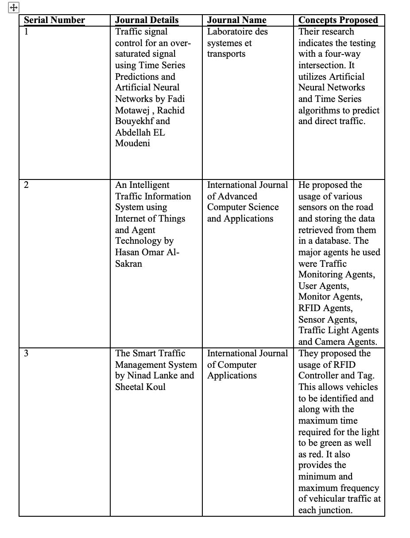
LITERATURE REVIEW

Slide 8
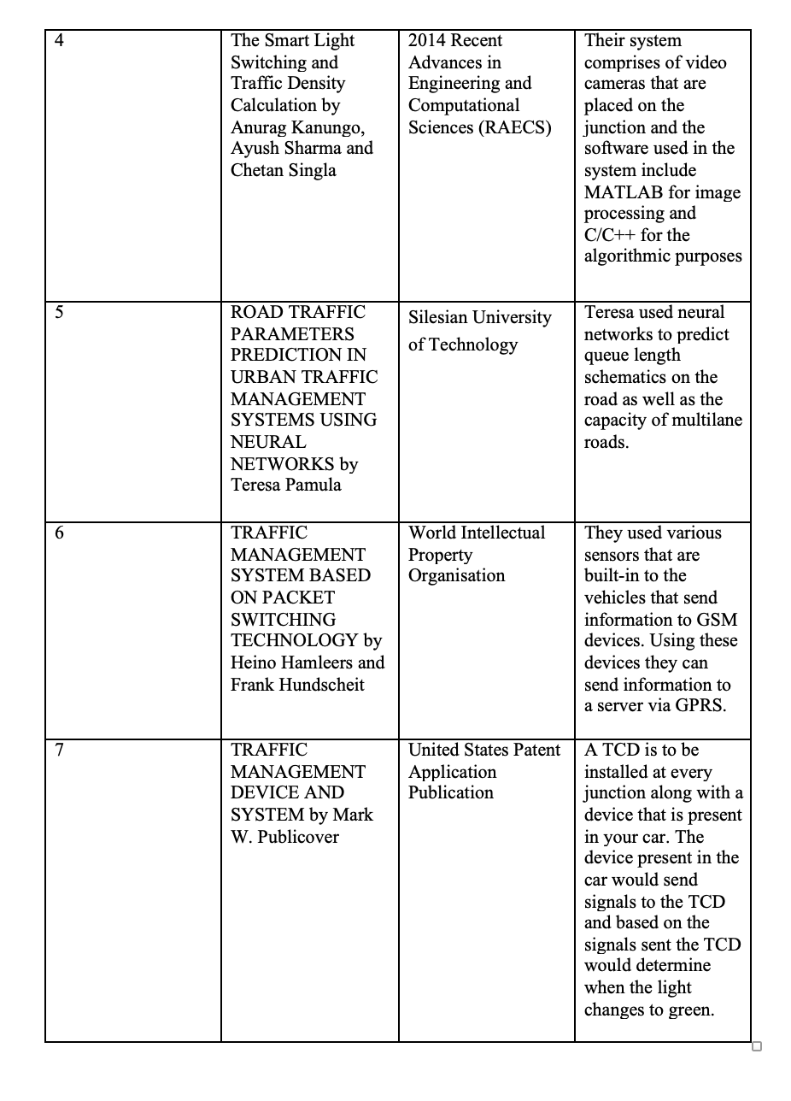

Slide 9
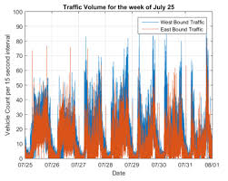
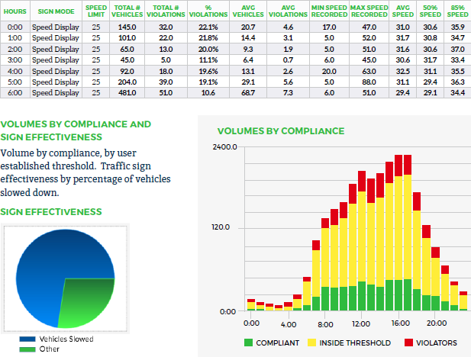
RESEARCH OBJECTIVE
Advance Traffic Management System will help us to achieve the following objective:
Increase transportation system efficiency
Enhance mobility
Improve safety
Reduce fuel consumption
Environmental cost
Increase economic productivity
Avoid delays in travelling
Incase of any emergency, a faster route can be decided beforehand since the possibilities and the probability of consumption can be detected and analyzed.
We will also understand the incorporation of Machine Learning algorithms and Artificial Intelligence which will be used to obtain the required statistics. Using Data Analysis, work will be done with various data sets to understand the pattern at each interval so that a suitable outcome can be reached.

Slide 10
PROBLEM DEFINITION
Our Project deals will focus on investigating, identifying and analyzing the probability or the possibility of traffic congestion from a given data set. The data set will be an historic data set which will contain the following parameters we will follow-
Vehicle count
Vehicle density
Type of vehicle
Time of the day
Location
The vehicle count will show the number of vehicles in the location traversing a particular route during a time of the day which will indicate the density of vehicles in that particular region. The type of vehicle refers to the size of vehicle or whether the vehicle is a two wheeler, three wheeler, four wheeler etc.
The time of the day will indicate and will help us obtain the time interval. The status of the traffic is different at different times of the day depending upon the peak hours and the non-peak hours which we can use to analyze the outcome and also identify a suitable pattern.
The location is not restricted and can be identified according to the requirement and needs.

Slide 11
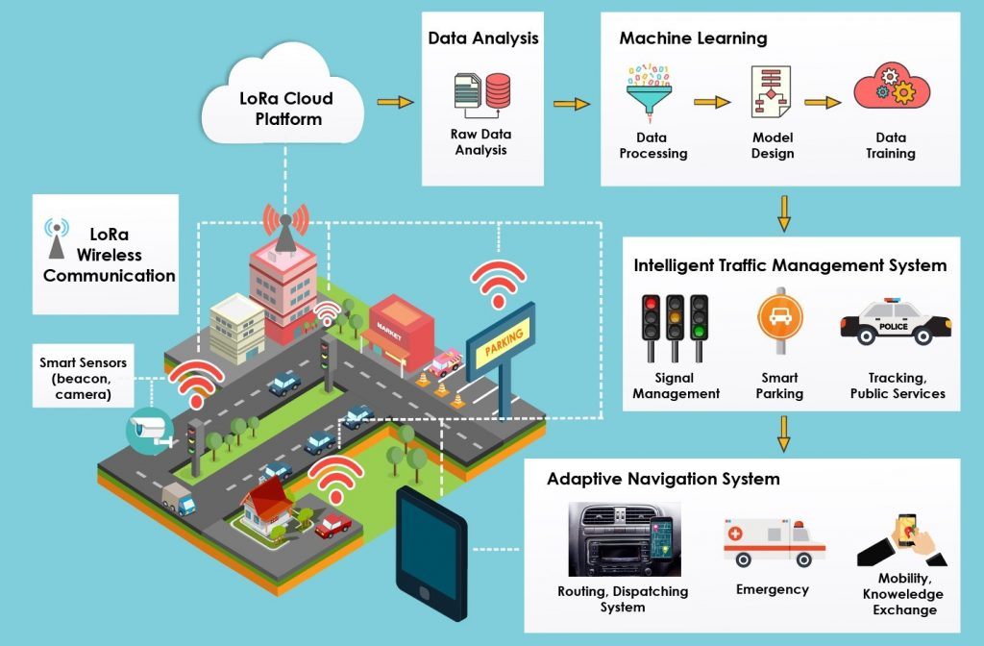
The project will examine the data available and will help to predict the traffic congestion which can occur. This will act as a warning signal and alert the crowd about the same.
To achieve this outcome we require the following steps-
Identify the data set with suitable parameters and requirements.
Import the dataset and process it.
Split the data into testing and training samples.
Employ various classiﬁers to predict the data with different sets of training samples.
Once the best predicting model is identiﬁed, will reduce the training set in size to test its limit.
While performing the former, various algorithms will be used pertaining to Machine Learning.
Once the model is ready, it will generate a suitable outcome using Artificial Intelligence incorporated in ML.

Slide 12
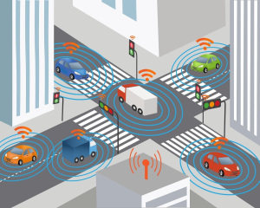
EXISTING SYSTEM
Current traffic management systems are limited in their abilities to adapt based on real-time traffic conditions. For example, traditional timing systems for traffic signals are programmed based on historical traffic data and are unable to dynamically adjust timing due to irregular events like traffic accidents and construction. Some major cities have implemented a synchronized traffic signal system with the goal of increasing traffic flows at major gridlock intersections. However, such systems are still based on a centralized approach. When flow is disrupted at any point within the system, say a traffic accident, it creates a knock-on effect and synchronized traffic signals are not able to adjust their pre-programmed timings accordingly.

Slide 13
REQUIREMENT ANALYSIS
Functional requirements
The data is checked and then trained using a particular algorithm. The outcome is noted. The testing data is then classified and the accuracy of the outcome is verified. The same procedure is repeated with different algorithms to develop the most efficient method of prediction by comparing the outcomes of each algorithm.
Non-functional requirements
Appropriate dataset is required for proper prediction of data. The program must be able to handle any challenges including incorrect data in the dataset and should be able to run smoothly. Suitable algorithms are required for the most efficient and accurate prediction for the given dataset.

Slide 14
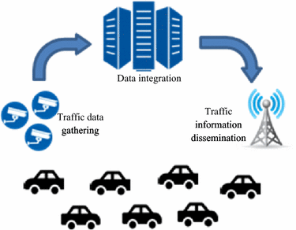
PROPOSED METHODOLOGY
Based on what has been explained here, traffic assignment must be combined with traffic optimization for giving the best service to network users. Also, traffic optimization should be mixed with traffic assignment to maximize the overall network efficiency. So ATMS can be organized as follows
Using traffic information to control traffic nodes.
Determining parameters of nodes to maximize efficiency.
Predicting traffic conditions for adjacent nodes.
Coordinating nodes together.
Predicting the percentage of network users distributed across the network.
Estimating the flow of network link.
Estimating the network ODM(origin destination matrix) in a hierarchical manner.
Estimating users’ network travel.
Updating traffic information for the next time interval.

Slide 15
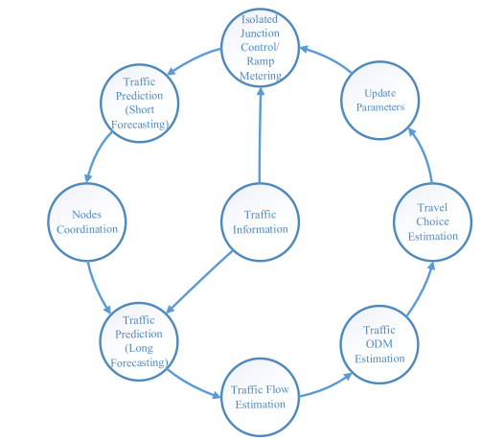
PROPOSED METHODOLOGY

Slide 16
ALGORITHMS
The majority of practical machine learning uses supervised learning.
Supervised learning is where you have input variables (x) and an output variable (Y) and you use an algorithm to learn the mapping function from the input to the output.
Y = f(X)
The goal is to approximate the mapping function so well that when you have new input data (x) that you can predict the output variables (Y) for that data.
Supervised learning problems can be further grouped into regression and classification problems.
Classification: A classification problem is when the output variable is a category, such as “red” or “blue” or “disease” and “no disease”.
Regression: A regression problem is when the output variable is a real value, such as “dollars” or “weight”.
Some common types of problems built on top of classification and regression include recommendation and time series prediction respectively.
Some examples of supervised machine learning algorithms which will be used are:
Neural networks
Decision Trees

Slide 17
SYSTEM DESIGN
DATA COLLECTION
PRE- PROCESSING DATA
BUILLDING MODEL
TRAINING
TESTING

Slide 18
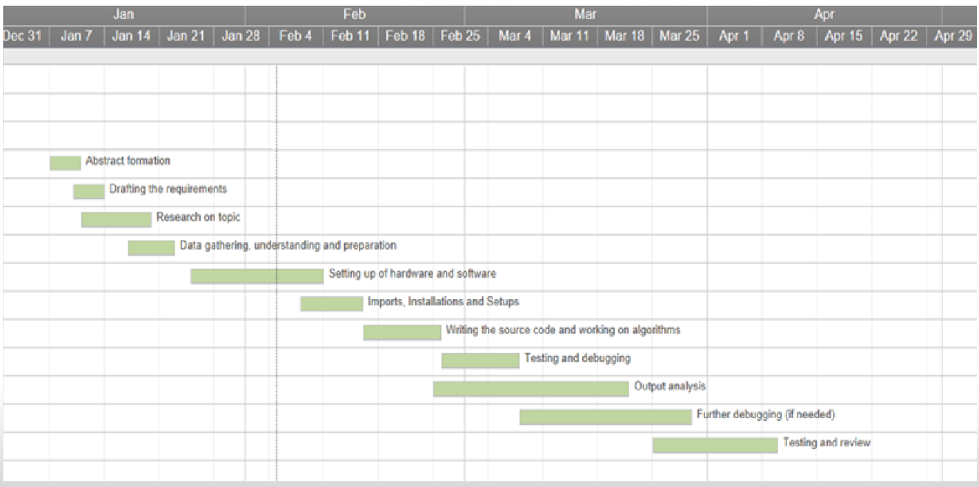
SCHEDULE PLAN

Slide 19
REFERENCES
“The hidden cost of congestion,” The Economist, 28-Feb-2018.
G. Leduc, “Road Traffic Data: Collection Methods and Applications,” 2008.
Google
Wikipedia
O. Rosas-Jaimes and L. Alvarez-Icaza, “Vehicle density and velocity estimation on highways for on-ramp metering control,” Nonlinear Dyn., vol. 49, no. 4, pp. 555–566, Sep. 2007

Slide 20
THANK YOU

